Slide 1



Slide 2
Presented By: -
Haidy Ayman
Shimaa Saad
Ibrahim Basal
Kadry Abo Elazab
Mohamed Sherif
Presented To: -
Eng. Nadia Saleh

Slide 3

Content
Introduction
Process
Tools
System Analysis
Reports & Dashboards
Application Design

Slide 4

Introduction
Online Examination System is a cost-effective, scalable way to convert traditional pen and paper-based exams to online. Candidates can appear for the exam using any desktop, laptop, or mobile device with a browser.
Exam results can be generated instantly for the objective type of questions.

Slide 5

Process
ERD
Mapping
Database Creation
Stored procedures
Select ,Insert update and delete in any table
Exam generation
Exam Answers & Correction
Exam Result
Reports
Dashboards
Desktop Application

Slide 6




Tools
Microsoft Excel.
Visual studio(SSIS, SSRS, Windows form)
Microsoft SQL server.
Power bi

Slide 7
System Analysis
ERD
Mapping
Database Creation

Slide 8
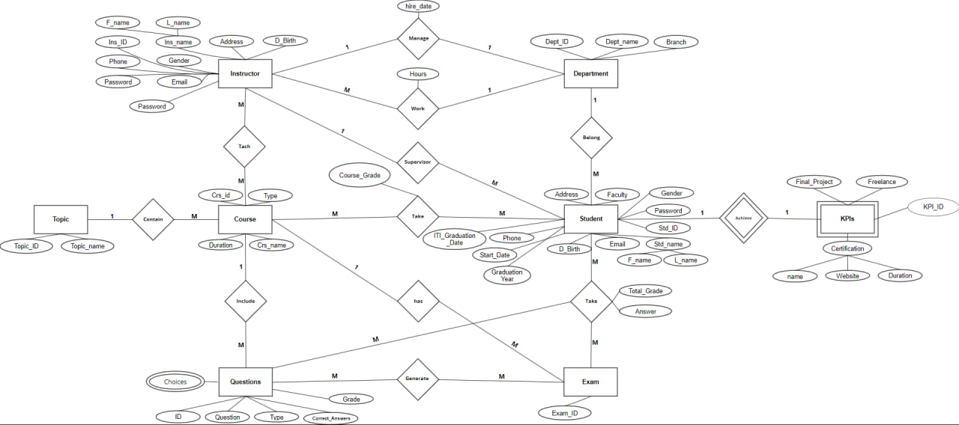
ERD

Slide 9
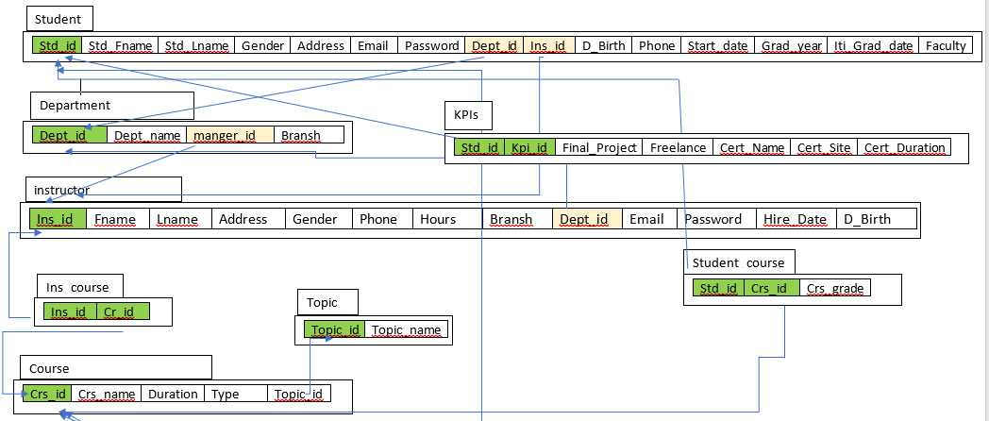
Mapping

Slide 10
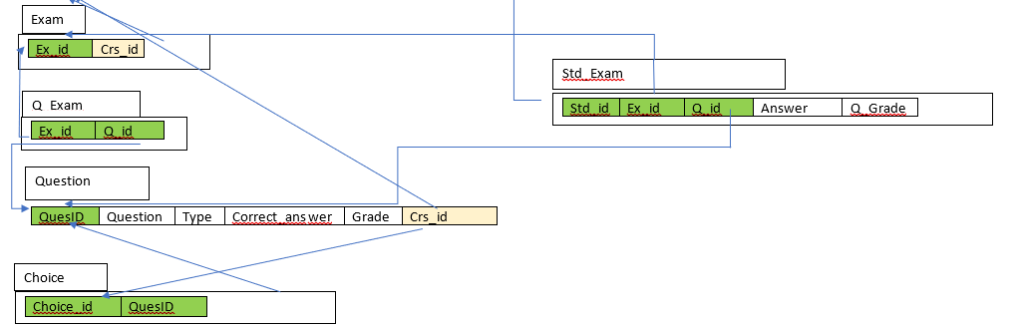

Slide 11

Reports

Slide 12
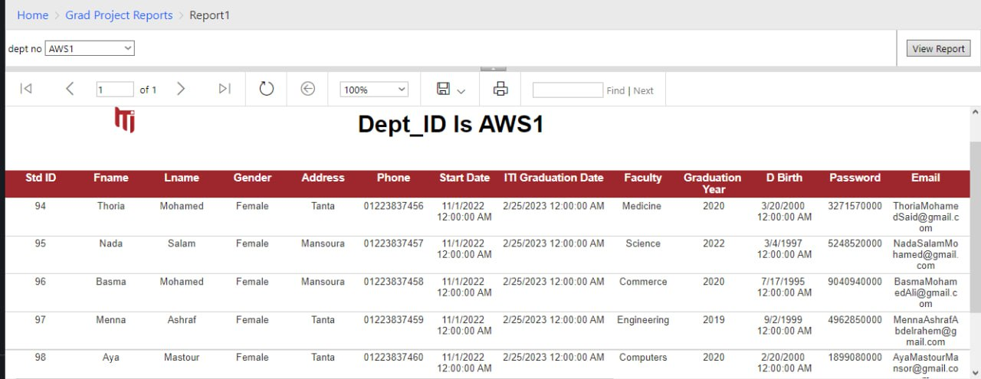
SSRS

Slide 13
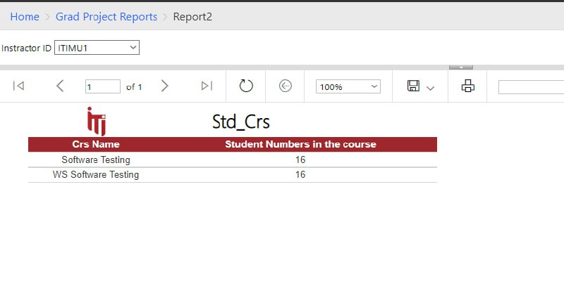
SSRS

Slide 14
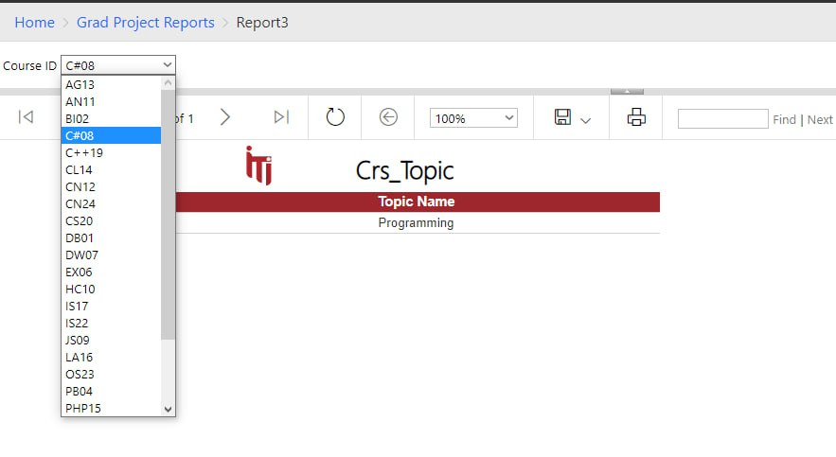
SSRS

Slide 15
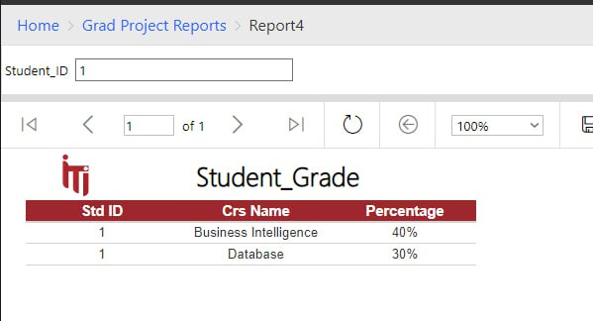
SSRS

Slide 16
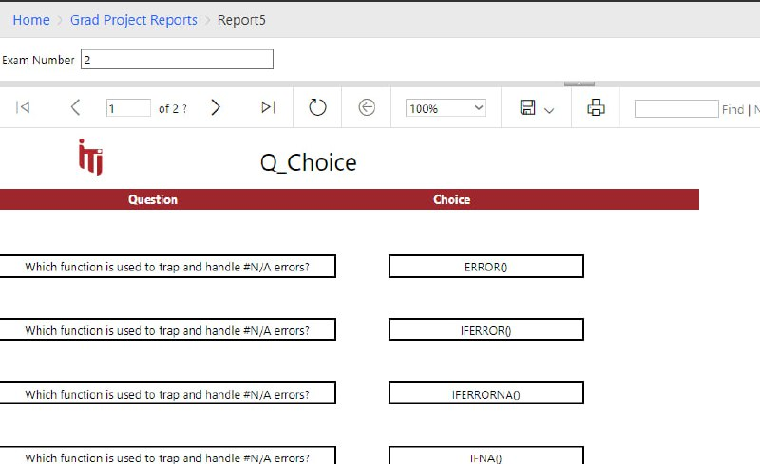
SSRS

Slide 17
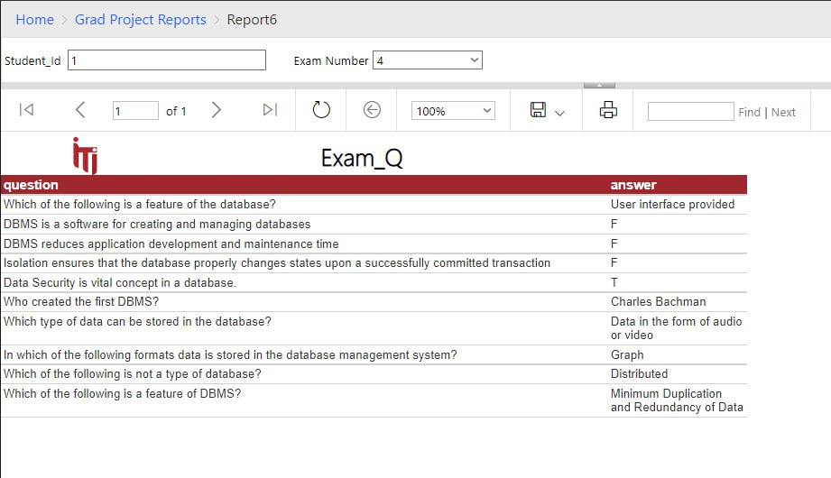
SSRS

Slide 18
Dashboards

Slide 19

Power BI

Slide 20
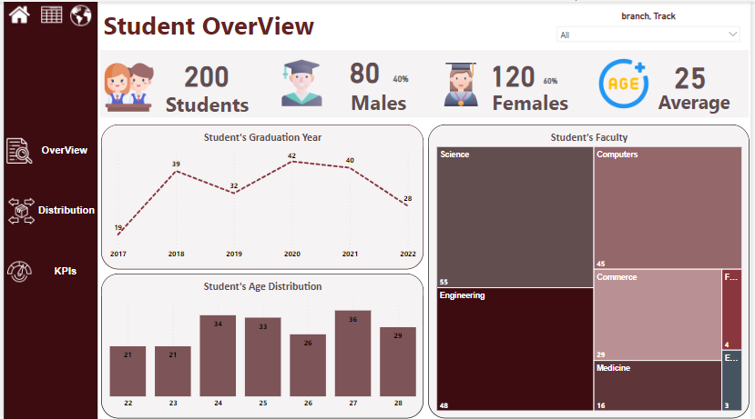
Power BI

Slide 21
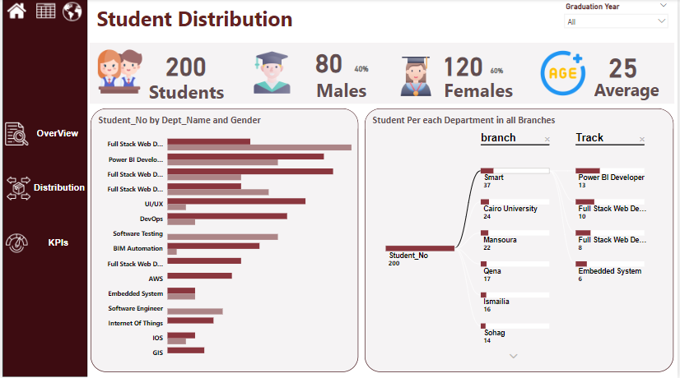
Power BI

Slide 22
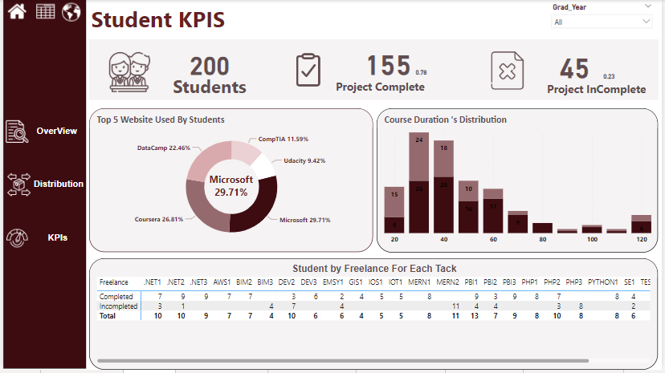
Power BI

Slide 23
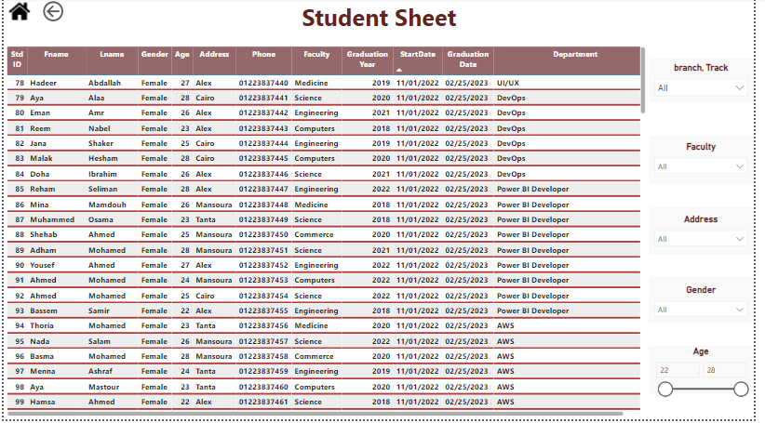
Power BI

Slide 24
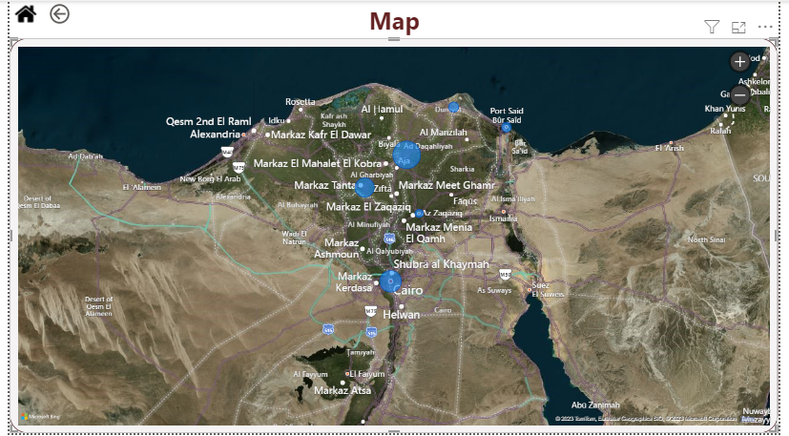
Power BI

Slide 25
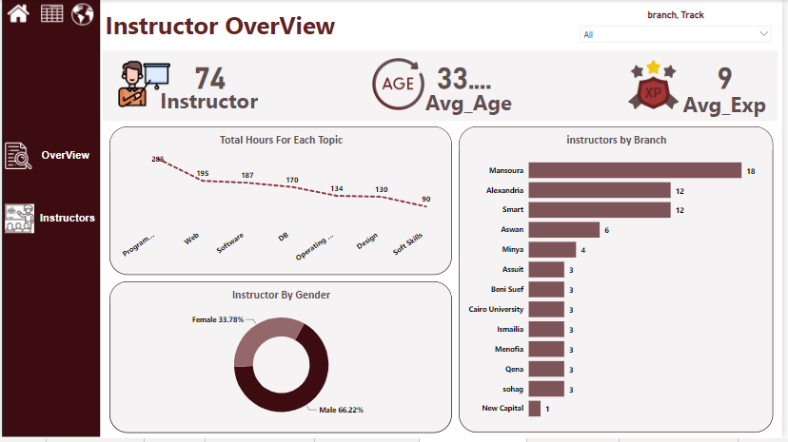
Power BI

Slide 26
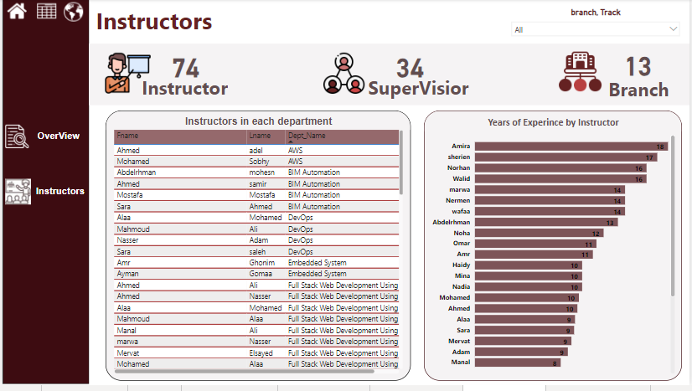
Power BI

Slide 27
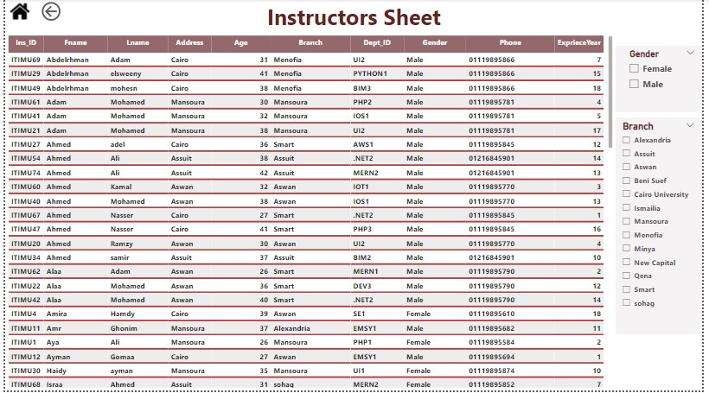
Power BI

Slide 28
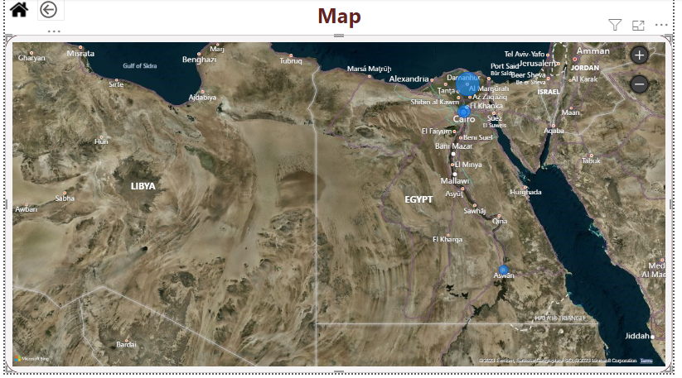
Power BI

Slide 29
Application Design

Slide 30
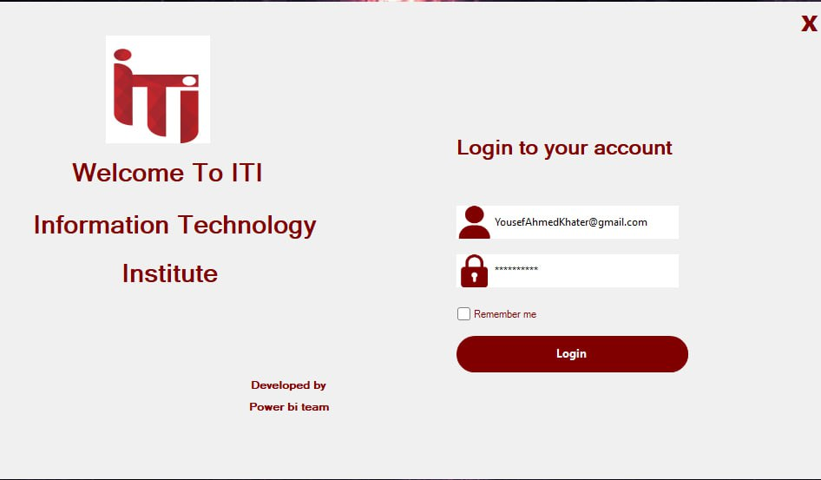
Application Design

Slide 31
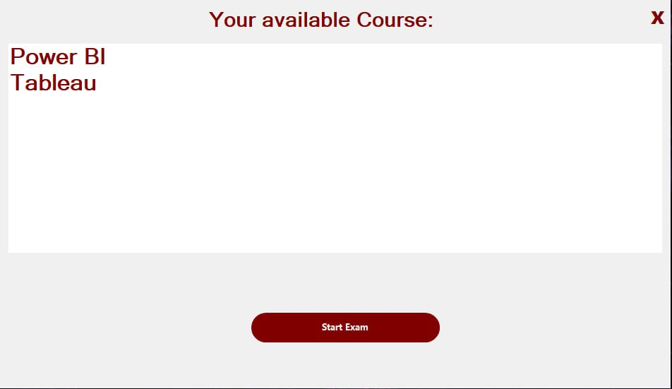
Application Design

Slide 32
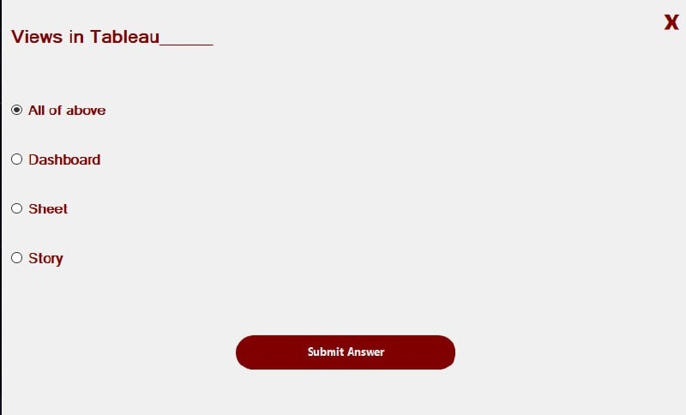
Application Design

Slide 33
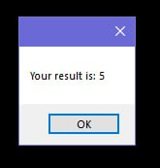
Application Design

Slide 34


